Slide 1
Review of Basics

Slide 2

Inductive Learning
Inductive learning or “Prediction”:
Given examples of a function (X, F(X))
Predict function F(X) for new examples X
Classification
F(X) = Discrete
Regression
F(X) = Continuous
Probability estimation
F(X) = Probability(X):
Inductive learning involves the process of learning by example – where a system tries to induce a general rule from a set of observed instances. Supervised learning is a form of inductive learning.

Slide 3
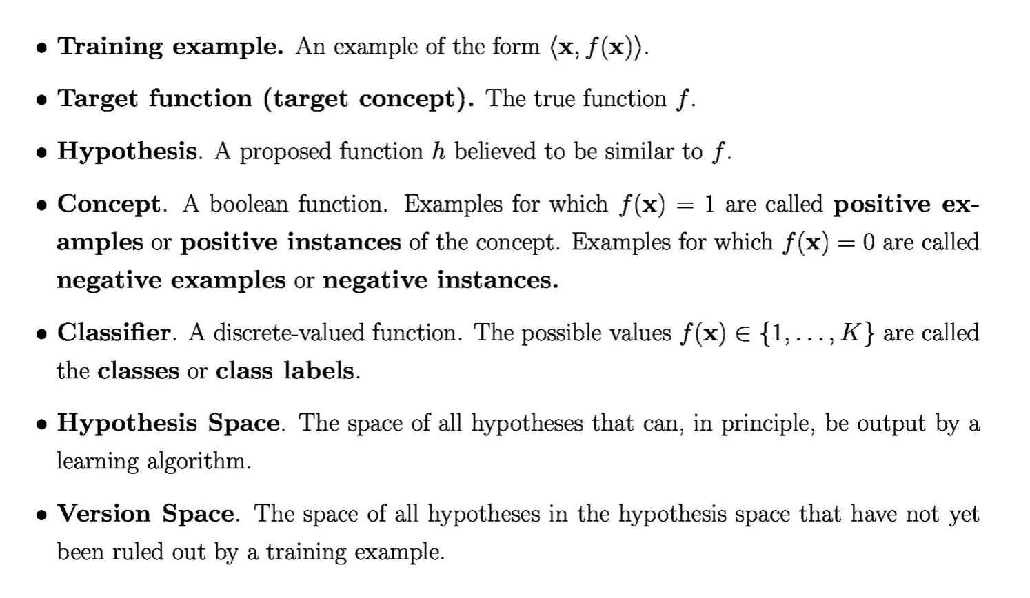
Terminology

Slide 4
Hypothesis Function
Hypothesis:
Function for labeling examples
0.0 1.0 2.0 3.0
+
+
Label: +
+
Label: -
?
+
-
+
+
-
-
-
-
+
+
-
?
?
-
+
-
-
+
-
-
+
+
+
-
?
-
0.0 1.0 2.0 3.0 4.0 5.0 6.0

Slide 5
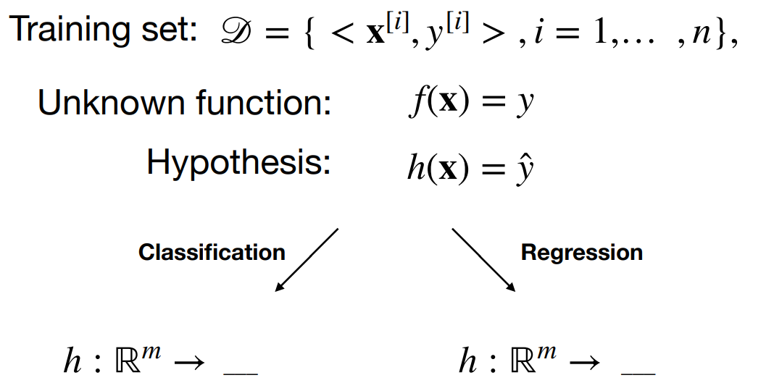
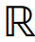
Supervised Learning – Formal Notation
{1, ..., k} , class labels k

Slide 6
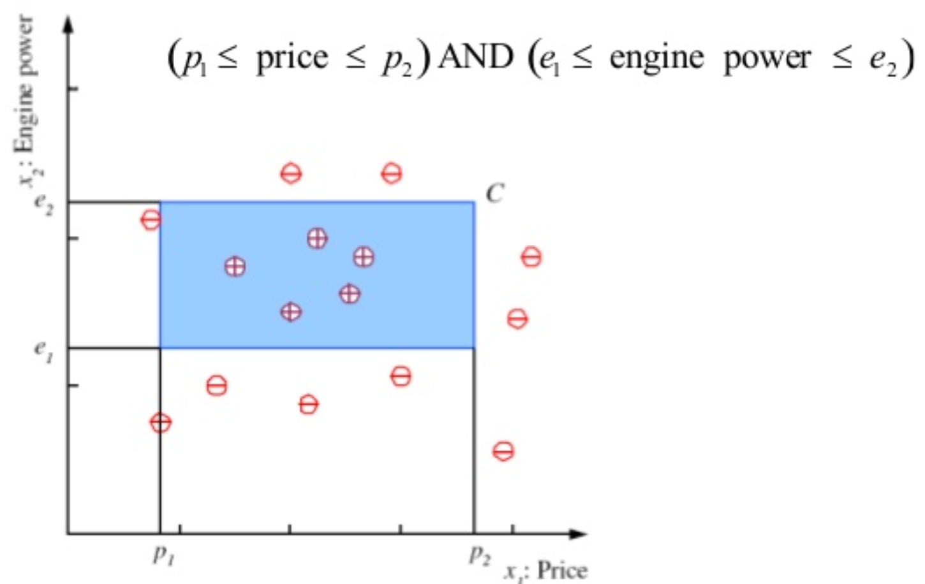
Hypothesis Function

Slide 7
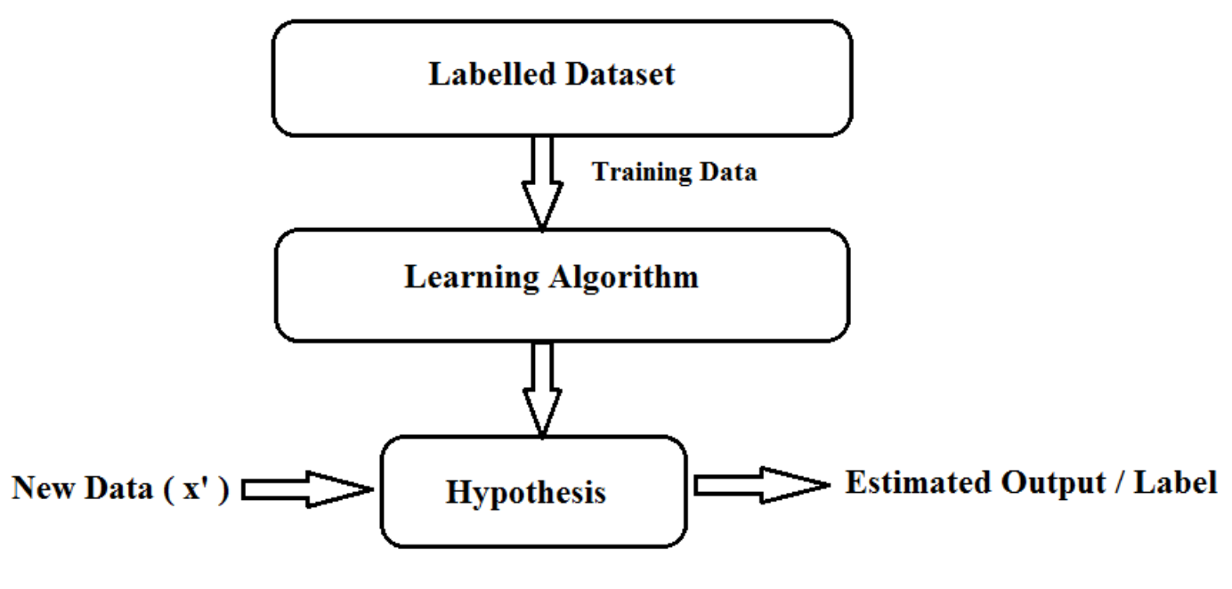
Hypothesis Function

Slide 8
Hypothesis Space

Slide 9
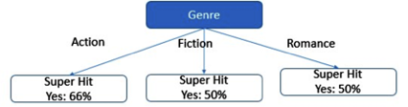
Hypothesis Space - Representations
1. Decision Tree
2. Linear Function

Slide 10
Hypothesis Space - Representations
3. Multivariate Linear Function 4. Single Layer Perceptron 5. Multi-Layer NN

Slide 11
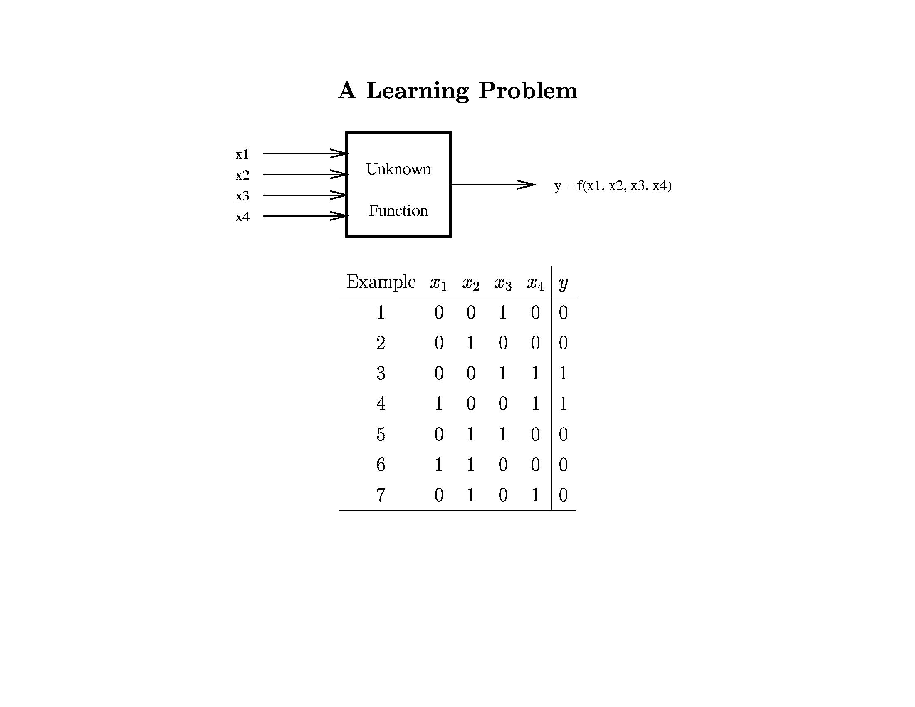
© Daniel S. Weld

Slide 12
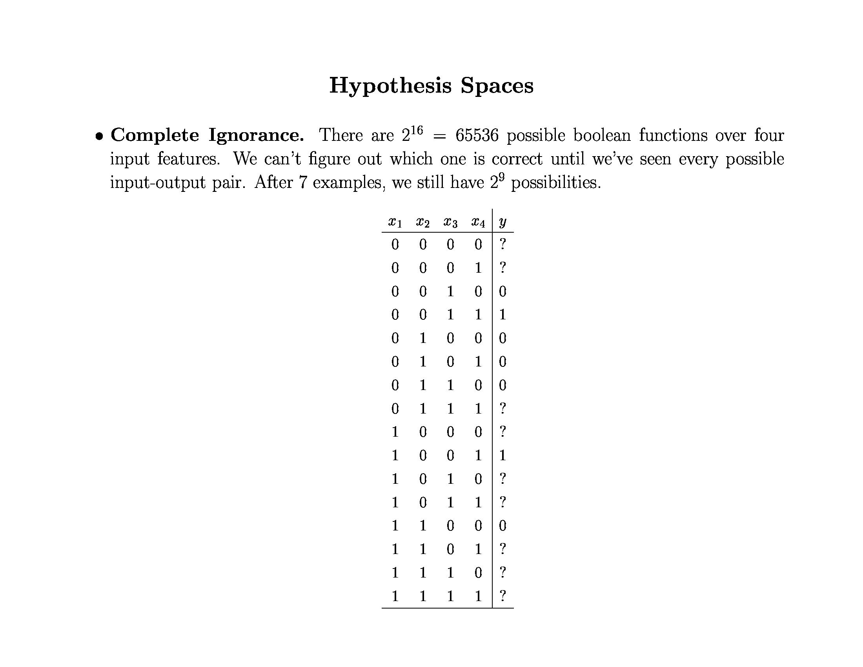
© Daniel S. Weld

Slide 13
Inductive Bias
Need to make assumptions
Experience alone doesn’t allow us to make conclusions about unseen data instances
Two types of bias:
Restriction: Limit the hypothesis space (e.g., look at rules)
Preference: Impose ordering on hypothesis space (e.g., more general, consistent with data)

Slide 14
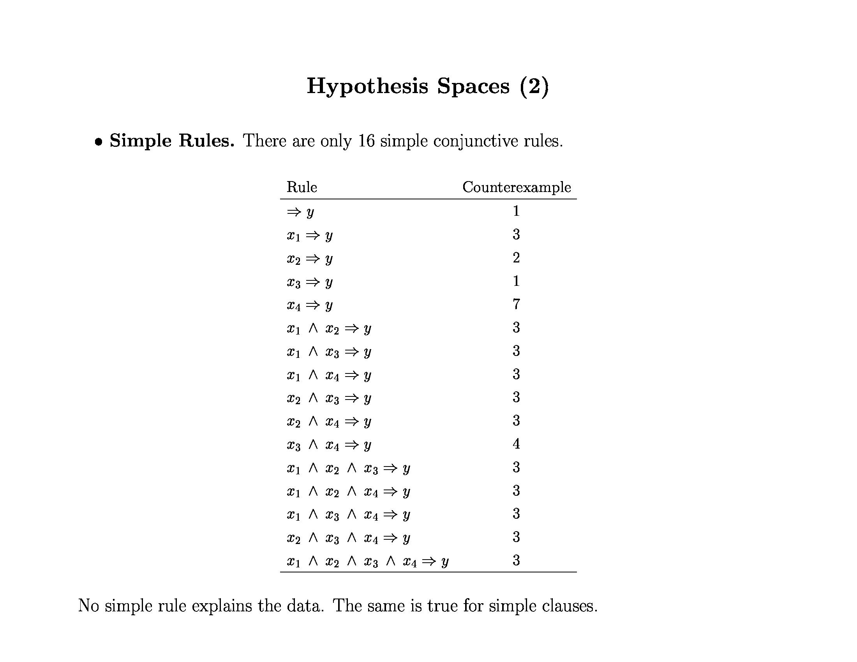
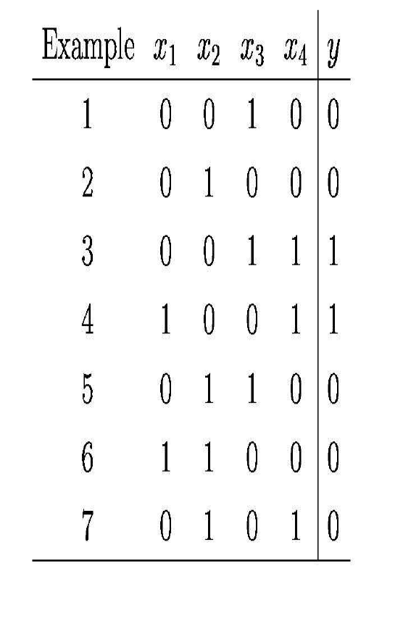
© Daniel S. Weld

Slide 15
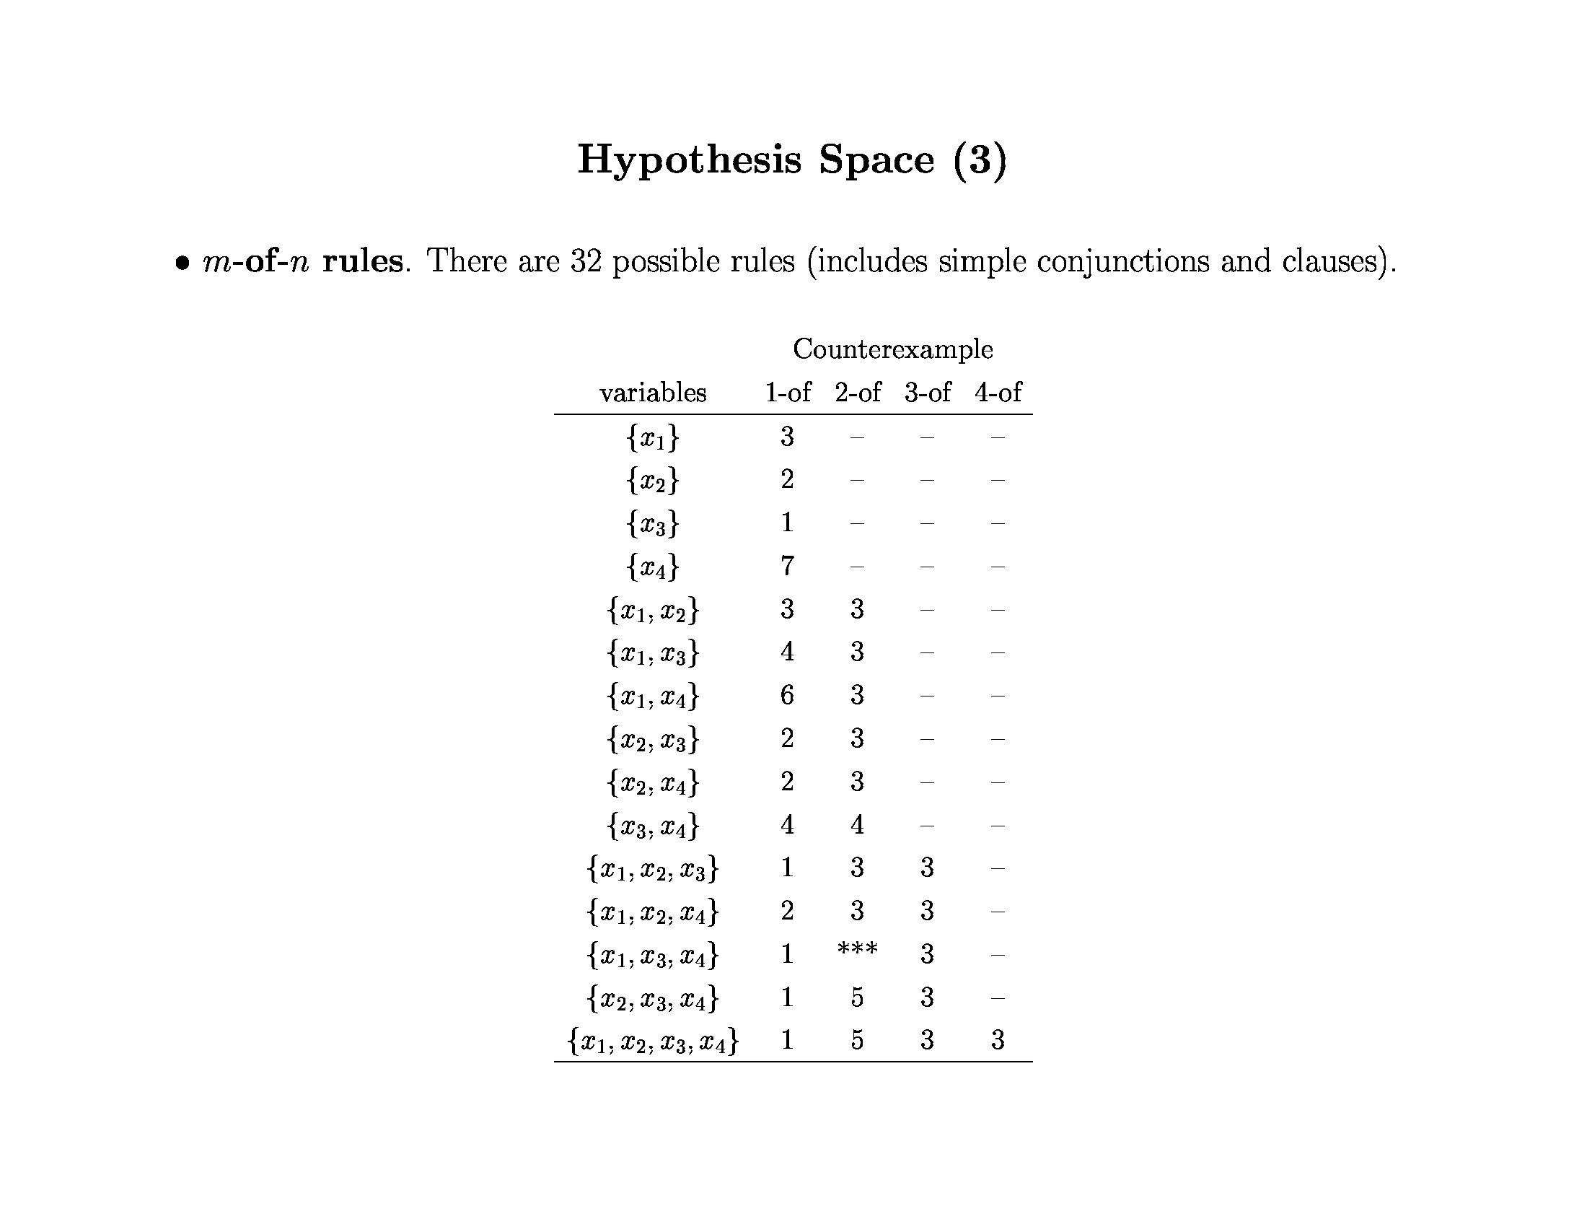
x₁ ⇒ y
x₃ ⇒ y
x₄ ⇒ y
© Daniel S. Weld

Slide 16
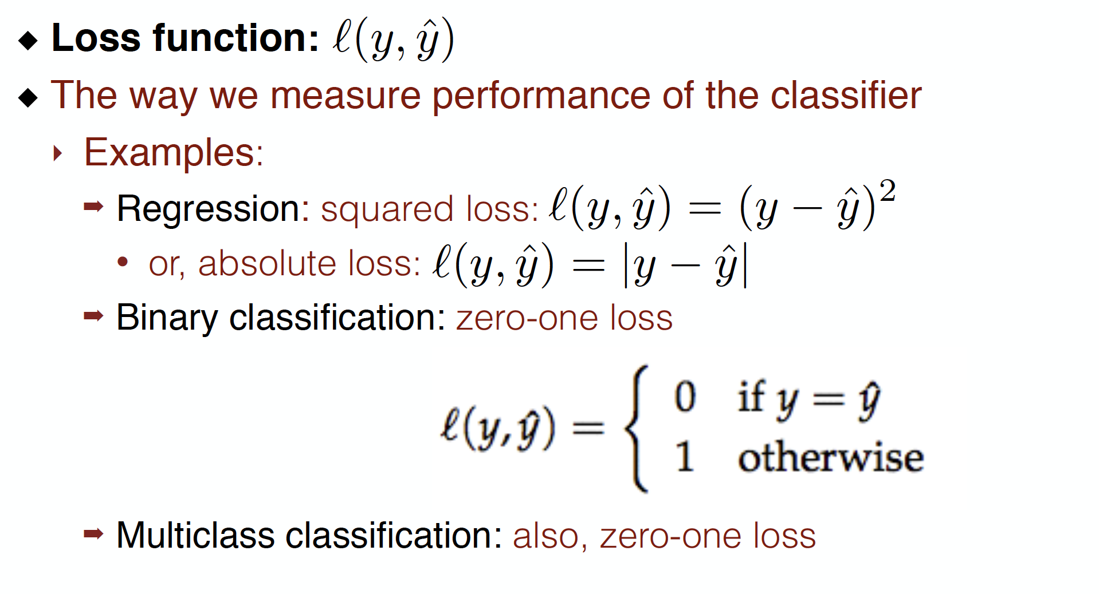
Formalizing the learning problem

Slide 17
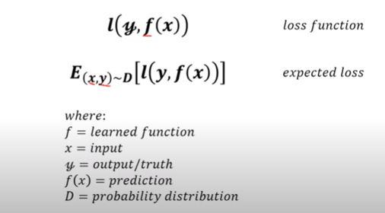
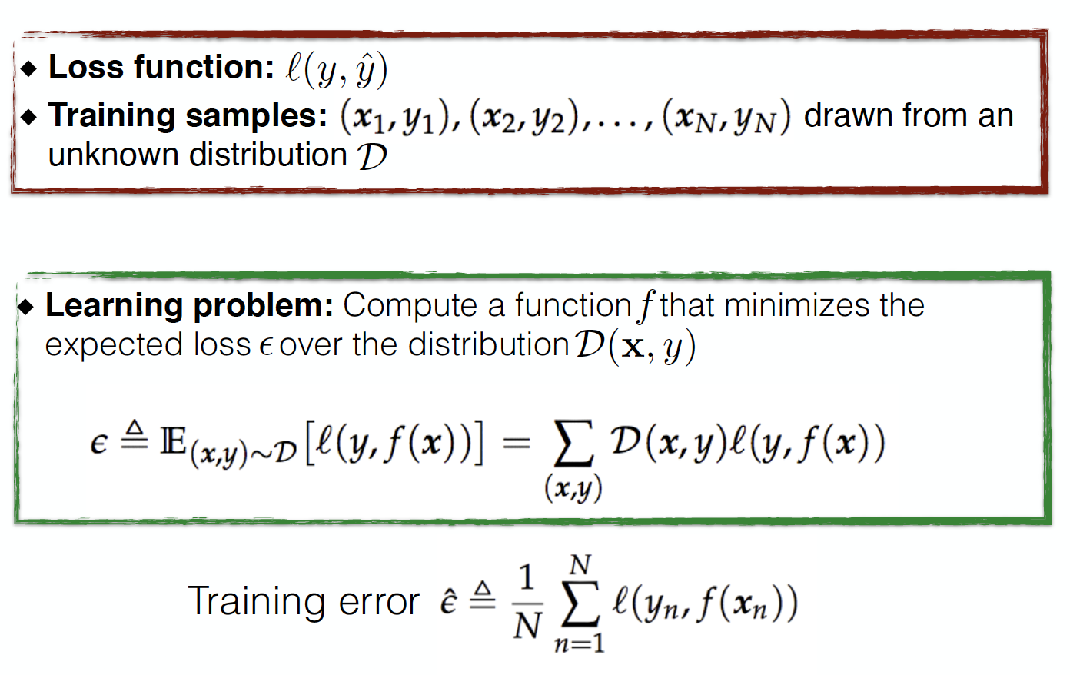
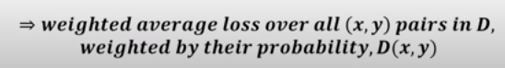
Formalizing the learning problem

Slide 18
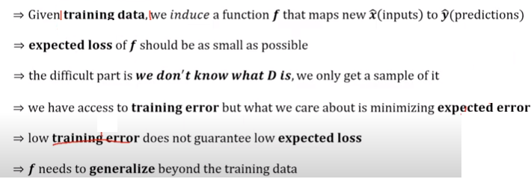
Difficulty in ML

Slide 19
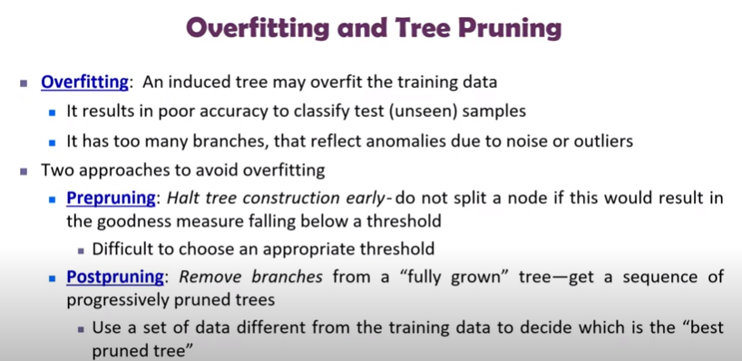

Slide 20
Memorization and Generalization
Memorization | Generalization
To commit to memory; learn so as to remember. | To form general principles or conclusions from detailed facts, experience, etc.
Memorizing, given facts, is an obvious task in learning | To identify the rules, to generalize, allows the system to make predictions on unknown data.
Done by storing the input samples explicitly, or by identifying the concept behind the input data, and memorizing their general rules | Removes the need to store a large number of input samples Reduce the amount of memory needed, and produce a very efficient method of memorization

